Slide 1
Concept Selection
By: Suzy Fendrick, Billy Ramm, and Robert Foster

Slide 2
Introduction
Team Name: Campus IPS
Our project is an IPS (indoor positioning system) mapping app for college campus to reduce the amount of students that get lost and increase their comfortability at school.
The motivation for our design idea stems from wanting to help out fellow college students and understanding that starting at a university can be difficult.

Slide 3
INFORMAL SELECTION
Multi-Voting & Pros and Cons

Slide 4
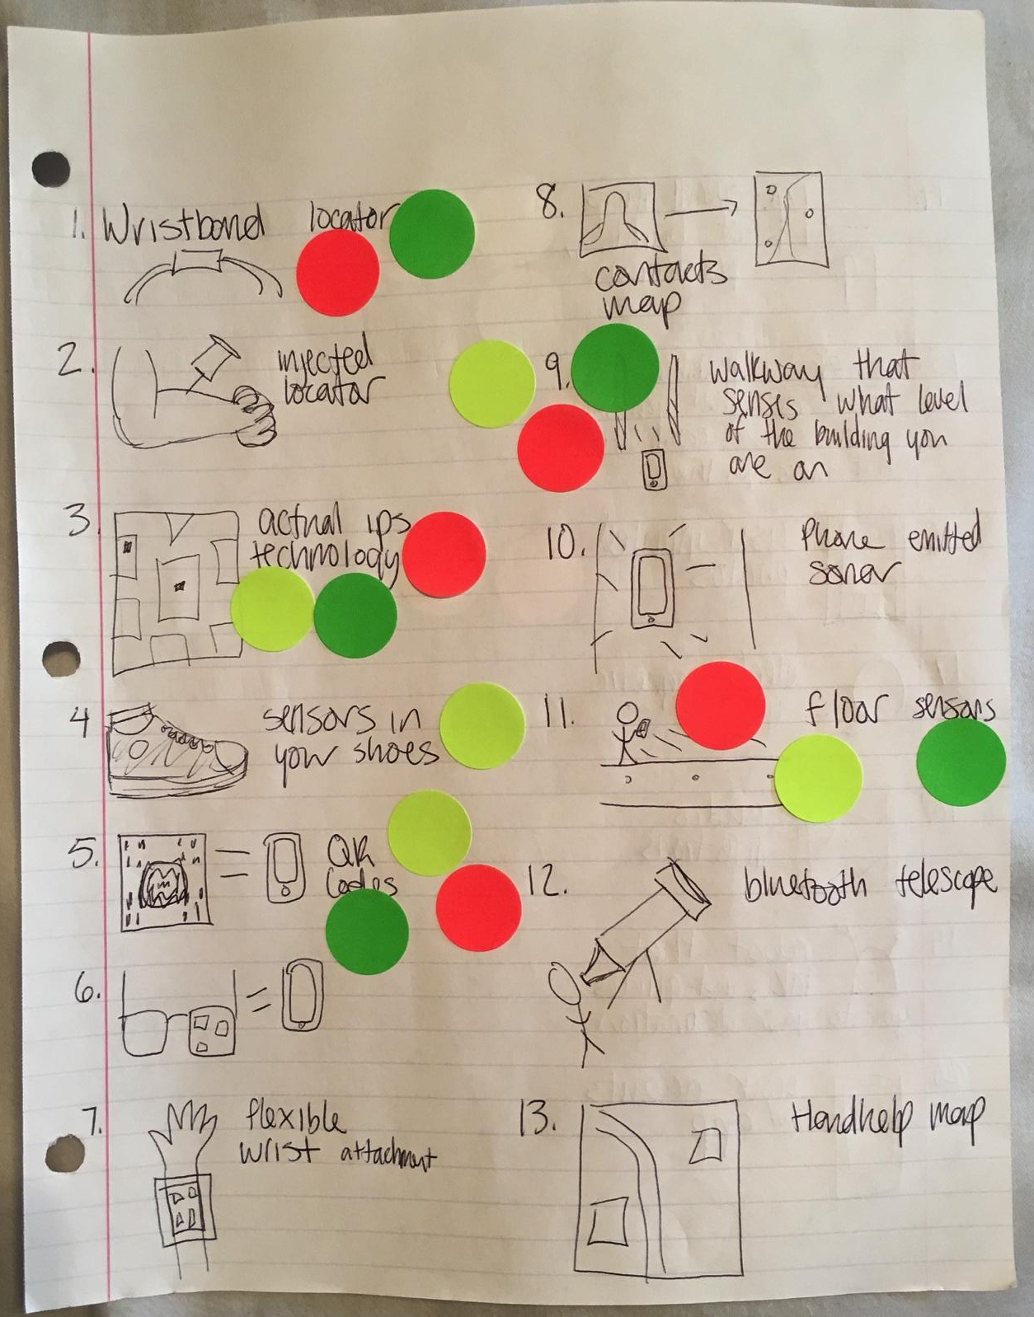
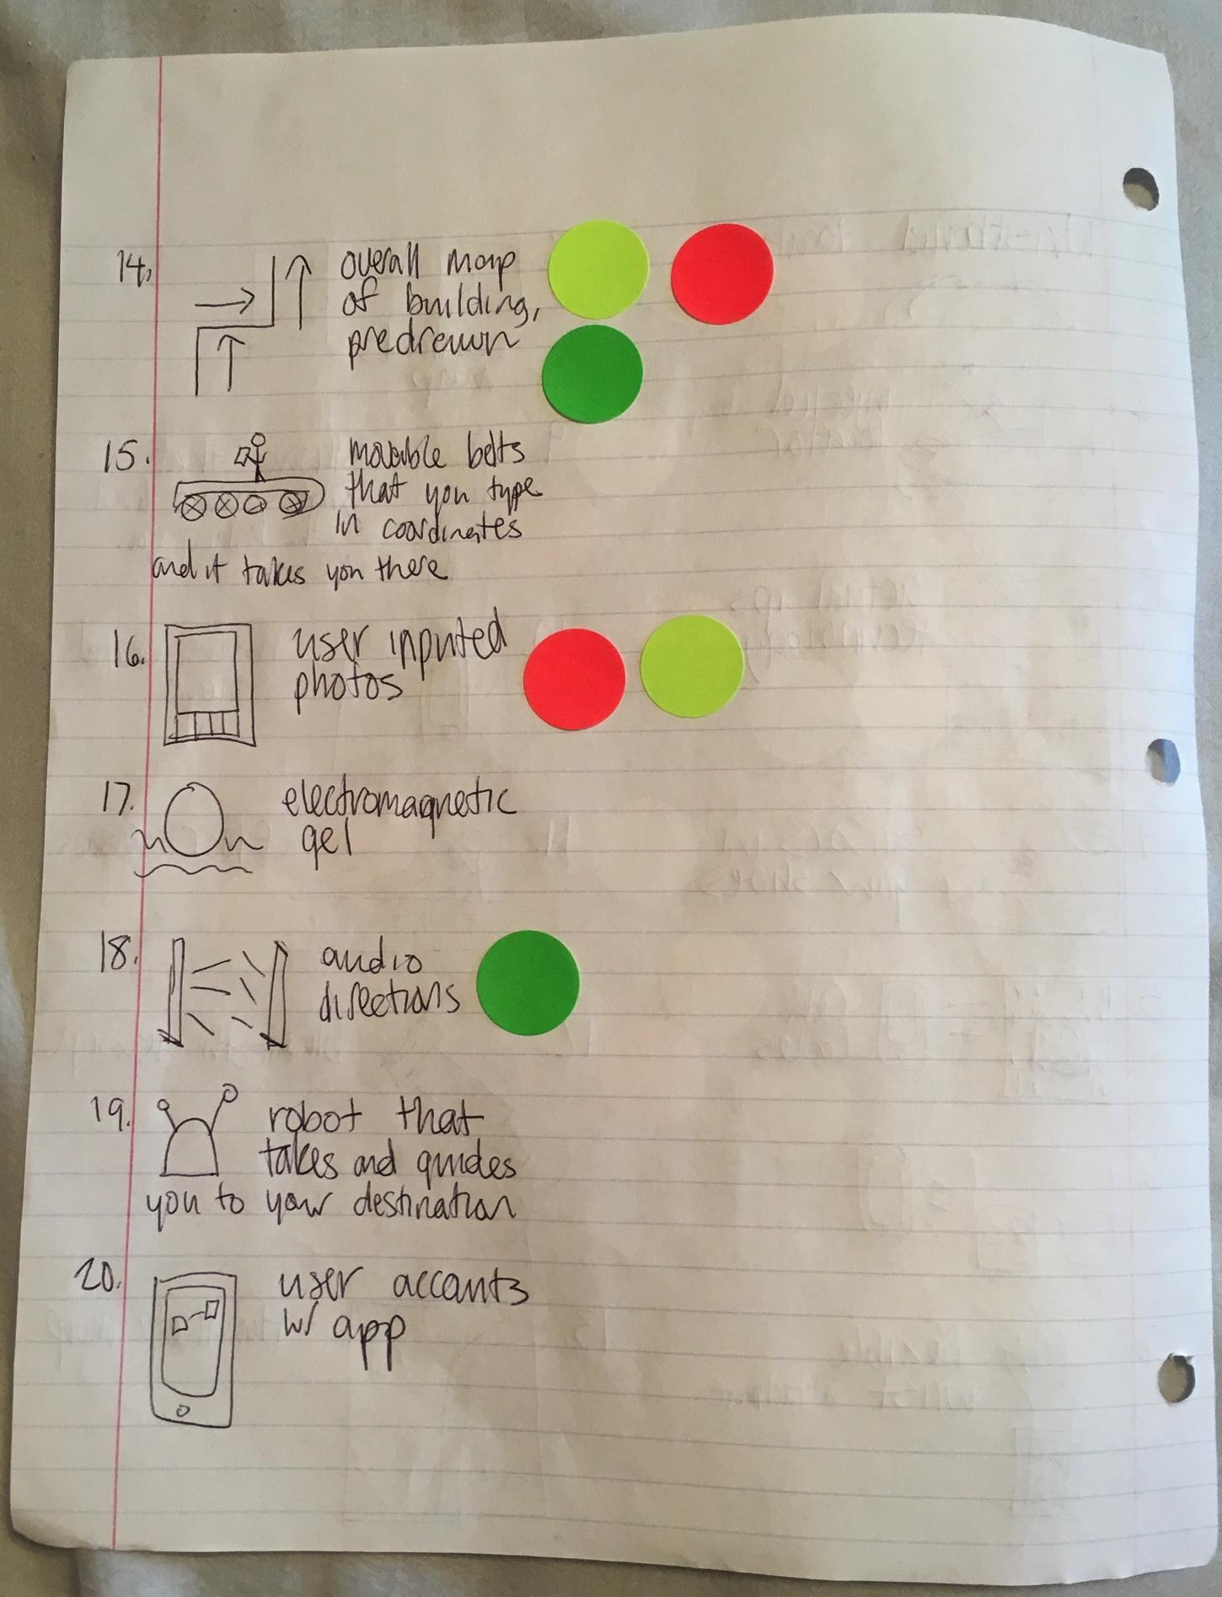
Multi-Voting

Slide 5
Multi-Voting
We choose multi-voting over other methods as it was our initial step in eliminating some of our ideas and focusing on the important ones.
Our team narrowed down our options from 20 to 5, as only 5 ideas ended up with 3 stickers (one from every team member) next to them.

Slide 6
Pros and Cons

Slide 7
Item | QR codes | Walk between | Overall map | Actual IPS | Floor Sensors
Pros | Application that’s already developed. We only need to build off of it. User friendly, easy to navigate. | Instantaneous upload of maps to your phone Uses frequencies that upload the maps to your phone, not requiring any stop and go actions. | Necessary server base that stores the data regarding our maps. Upload it to an existing technology such as google maps, so the only renovations that need to be done is the actual mapping. Startup cost is low due to working off an already existing technology | Already invented, so we’d be capitalizing upon an addition to the service. All the bugs of the actual IPS service have already been worked through, so that will save a lot of time on production. | Similar to the walk between, uses frequencies that sends the information to your phone. Very user friendly Easily accessible Constant information is being sent to your phone, so it’s constantly updating.

Slide 8
Cons | Outdated technology Requires another technology to access our database. Not everyone will have a qr code reader to access the maps their trying to obtain. | Bulky equipment that may take up to much space. Price of installing this technology at each entrance may run high. Phones may not pick up the frequency codes that are being transmitted through the towers. Maintenance necessary as the towers age or break. | Our services depend upon another products software. Maintenance will be a tricky situation when working with another software program. | Will have to create an innovated idea that works with the already invented technology, which would have to be with the price tag Will have to figure out how to get a 60k installation price to drop down to a simple download of an app on the phone, without installation fees. | Will have to develop a technology that hasn’t been invented yet, based upon principles of weight distribution in the floor or sensors being sent out from various objects. May be pricey such as the current actual ips services. Maintenance will require an onsite person to fix the technology. Scans may not be interpreted correctly and give ghost locations based on detecting various objects that it may think are human beings.

Slide 9
Pros and Cons
Each idea that we selected is different than the one before it, none to are exactly alike. Regarding a mapping system we had to distinguish what ideas we’re viable and how complex of the system it is, taking in to effect current technologies that are already on the market.
First regarding the Qr code, the concept is easy, the technology is already out there. Almost to simplistic and can only provide maps.
For the actual IPS all we would have to do is take a system that’s already developed and created a cheaper way to make this available to the consumer.
Coming into the walk between, the technology of using signals when you walked through two poles seemed like a great idea. Then we had to come down to what the cost would be, installation, maintenance, and then those facts started bringing down the value of the idea.
When we looked at overall maps, that would be developing an addition to an already existing software and using their platform, all we would be doing here is making an addition.
Looking at floor sensors, this technology seemed very appealing, the idea is something that is unique. But when we got to the brass tacks of the idea, the price started seeming overwhelming when taking into account the actual installation, including either beams of light, or a weight sensor, then to create a system that shoots it to your phone. With all that going on, would have to assume other problems may not happen, such as ghost reads, reading inanimate objects as a person, the bug list would be very high and almost improbable.
Overall was a couple key factors. What the price would be, is it doable,and is not impeding on another invention?

Slide 10
FORMAL SELECTION
Pugh’s Concept Selection Matrix

Slide 11
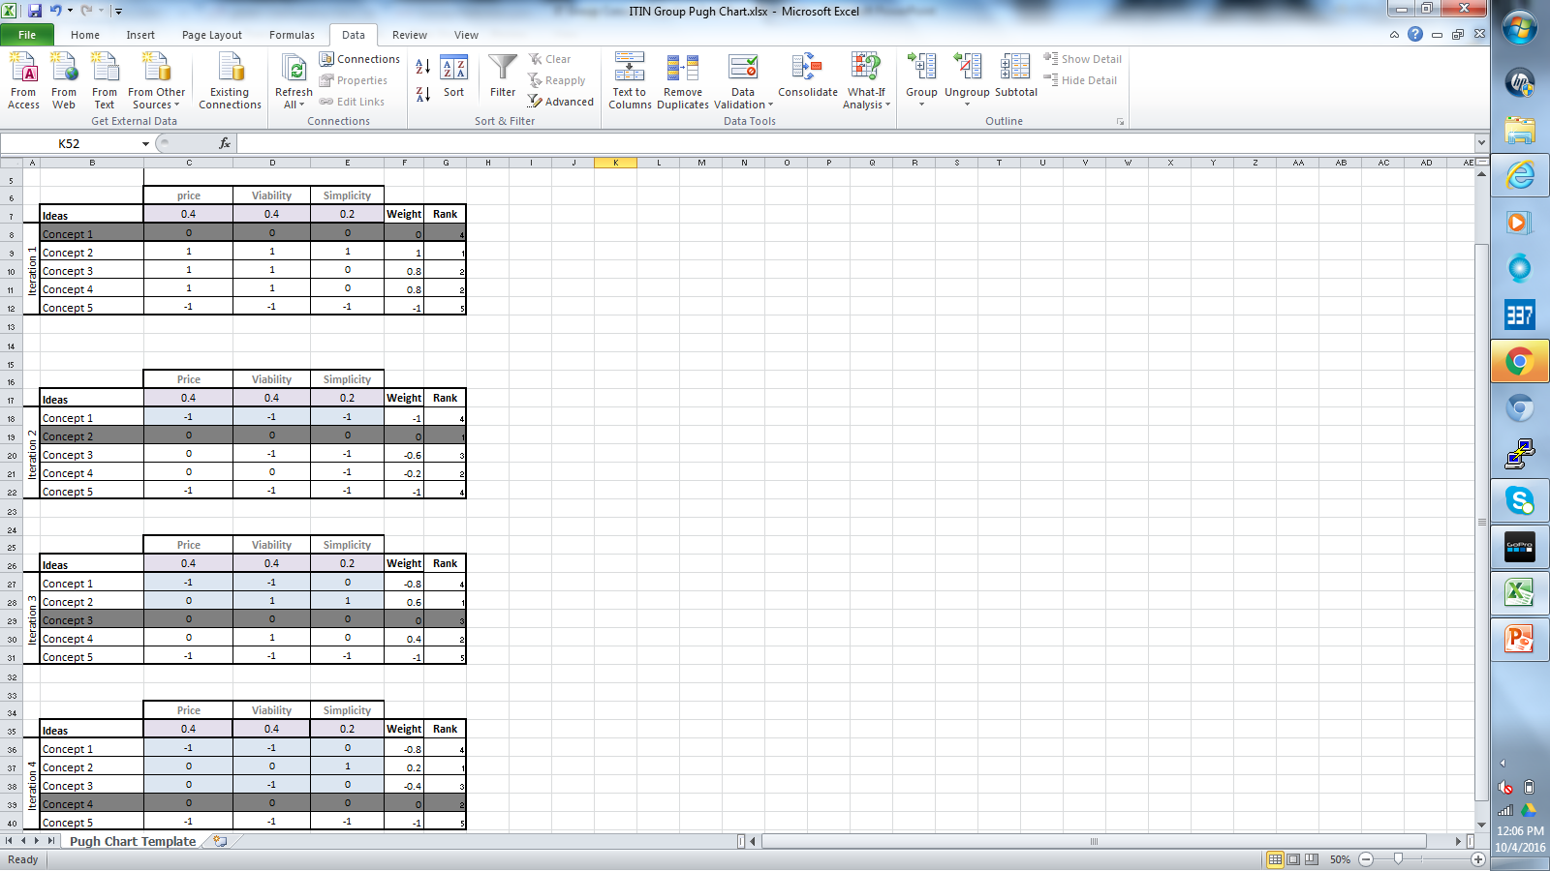
Pugh’s Concept Selection Matrix

Slide 12
Pugh’s Concept Selection Matrix
Through the use of our chosen weighted criteria (Price, Viability, and Simplicity) and comparing these criteria in our ideas to one another, we were able to come up with a formal ranking of our ideas.
1st Place : Concept 2 – Using QR Codes
2nd Place : Concept 4 – Overall mapping of campus/ buildings
3rd Place : Concept 3 – “Walk Between” sensors
4th Place : Concept 1 – IPS
5th Place : Concept 5 – Floor sensors

Slide 13
Informal Discussions
What molded our idea?:
At first we we’re left with the basic ips idea, with a system that included the outside navigation as well, so the potential “lost student,” can find his way. Our idea has always been very similar to the beginning of the thought process, but implementation and design had to be able to support the idea.
Collaborating together we we’re able to take our design process and put it all together to come up with a system that would suit the user more on the ips side since there are so many gps systems out there. We we’re able to develop a platform that we believe would support our software.

Slide 14
Winning Idea
Our winning idea is a combination of two of our ideas: the QR Code idea and the Overall mapping idea. We chose this because they ranked high in our methods and they can be combined.
The overall mapping idea lacks a mapping perspective from the inside of the building and the QR codes lack a mapping perspective from outside of a building. When you put them together they seem to further satisfy the needs of the user.

Slide 15
Additional Insights
One major insight gained was the idea that we could combine two of our best ideas and that we could actually benefit from doing so. We had not previously considered this and with out using our comparison methods, we may have never had this insight.
Our team will now focus on implementing both of these ideas together to create an ideal mapping system for our user.

